Slide 1
پایگاه داده 2 DATA WAREHOUSE
بنام خدا
بصیری
دانشکده برق و کامپیوتر
دانشگاه صنعتی اصفهان

Slide 2
مراجع
Han, Jiawei, Micheline Kamber, and Data Mining. "Concepts and techniques." Morgan Kaufmann 340 (2006): 94104-3205.‏
Kimball, Raiph. The data warehouse toolkit. John Wiley & Sons, 2006.‏
Inmon, William H. Building the data warehouse. John wiley & sons, 2005.‏

Slide 3
What’s a Data Warehouse?
انـبـار داده یک منبع واحد از داده‌هــاست که داده‌های منابع مختلف اطلاعاتی سازمان در آن جمع آوری، دسته‌بندی، خلاصه‌سازی و ذخیره شده تا تصمیم‌گیری را در سازمان تسهیل نماید.
برای دسترسی آسان کاربران به حجم زیادی از داده‌ها طراحی شده است، و دسترسی به دیتا عموما به وسیله ابزارهای تحلیلی ویژه و اپلیکیشن‌ها پشتیبانی می‌شود.
ابزارهای OLAP دسترسی به انبارداده را تسهیل نموده است.

Slide 4
هوش تجاری (Business Intelligence)
اطلاعات مناسب
زمان مناسب
افراد مناسب
هوش تجاري يعني دراختيار قراردادن اطلاعات مناسب به افراد مناسب در زمان مناسب براي اخذ تصميم مناسب

Slide 5

BI Architecture
DATA SOURCES STORAGE AREA DATA WAREHOUSE DECISION SUPPORT
Application Databases
______________________________________________________
Packaged application/ERP Data
DATA MARTS
EXTRACTION
TRANSFORMING
Loading
(ETL)
Reports
DATA
WAREHOUSE
Desktop Data
OLAP
External Data
Web-based Data
Statistical & Financial Analysis

Slide 6
ابزارهای هوش تجاری
BizzScore Suite
Board Management IntelligenceToolkit
Business Objects Enterprise
IBM Cognos
JasperSoft
Microsoft BI tools
Microstrategy
Oracle
WebFocus
Tableau Software
Style Intelligence
SAS
SAP
QlikView
Pentaho BI Suite
Actuate
.......

Slide 7

چرا به انبار داده و هوش تجاری نیاز داریم؟
نیاز به یک چارچوب تصمیم‌گیری برای تسریع در اتخاذ تصمیمات موثر
دسترسی سریع به تمام اطلاعات موجود
امکان ساخت هر گونه گزارش به صورت دینامیک
امکان تحلیل اطلاعات به صورت Historical(مبتنی بر زمان) از کل به جزء(Drill Down) با استفاده از تجمیع ها(Aggregation)
امکان انجام تحلیلهای آماری و مبتنی بر داده کاوی
ایجاد مرجع واحد آمار و گزارشات
امکان برنامه نویسی و تولید نرم افزارهای خاص منظوره

Slide 8
Data Warehouse Characteristics
Key Characteristics of a Data Warehouse
Integrated
Time-variant
Non-volatile
Subject-Oriented
Fast
انباره داده
یکپارچه
غیر فرار
مرتبط با زمان
موضوع محور
سریع

Slide 9




Integrated(یکپارچه)
Data is stored once in a single integrated location (e.g. insurance company)
Auto Policy
Processing
System
Data Warehouse
Database
Customer
data
stored
in several
databases
Fire Policy
Processing
System
FACTS, LIFE
Commercial, Accounting
Applications
Subject = Customer

Slide 10
Data Warehouse—Time Variant(مرتبط با زمان)
The time horizon for the data warehouse is significantly longer than that of operational systems
Operational database: current value data
Data warehouse data: provide information from a historical perspective (e.g., past 5-10 years)
Every key structure in the data warehouse
Contains an element of time, explicitly or implicitly
But the key of operational data may or may not contain “time element”

Slide 11
Non-Volatile (غیر فرار)
Existing data in the warehouse is not overwritten or updated.
External
Sources
Production
Databases
Data
Warehouse
Database
Data
Warehouse
Environment
Production
Applications
Load
Read-Only
Update
Insert
Delete

Slide 12
Data Warehouse—Subject-Oriented(موضوع محور)
Organized around major subjects, such as customer, product, sales
Focusing on the modeling and analysis of data for decision makers, not on daily operations or transaction processing
Provide a simple and concise view around particular subject issues by excluding data that are not useful in the decision support process

Slide 13
Data Warehouse vs. Operational DBMS
OLTP (on-line transaction processing)
Major task of traditional relational DBMS
Day-to-day operations: purchasing, inventory, banking, manufacturing, payroll, registration, accounting, etc.
OLAP (on-line analytical processing)
Major task of data warehouse system
Data analysis and decision making
Distinct features (OLTP vs. OLAP):
User and system orientation: customer vs. market
Data contents: current, detailed vs. historical, consolidated
Database design: ER + application vs. star + subject
View: current, local vs. evolutionary, integrated
Access patterns: update vs. read-only but complex queries

Slide 14
OLTP vs. OLAP

Slide 15
Why Separate Data Warehouse?
High performance for both systems
DBMS— tuned for OLTP: access methods, indexing, concurrency control, recovery
Warehouse—tuned for OLAP: complex OLAP queries, multidimensional view, consolidation
Different functions and different data:
missing data: Decision support requires historical data which operational DBs do not typically maintain
data consolidation: DS requires consolidation (aggregation, summarization) of data from heterogeneous sources
data quality: different sources typically use inconsistent data representations, codes and formats which have to be reconciled
Note: There are more and more systems which perform OLAP analysis directly on relational databases

Slide 16
From Tables and Spreadsheets to Data Cubes
A data warehouse is based on a multidimensional data model which views data in the form of a data cube
A data cube, such as sales, allows data to be modeled and viewed in multiple dimensions
Dimension tables, such as item (item_name, brand, type), or time(day, week, month, quarter, year)
Fact table contains measures (such as dollars_sold) and keys to each of the related dimension tables
In data warehousing literature, an n-D base cube is called a base cuboid. The top most 0-D cuboid, which holds the highest-level of summarization, is called the apex cuboid. The lattice of cuboids forms a data cube.

Slide 17
Cube: A Lattice of Cuboids
all
0-D(apex) cuboid
time
item
location
supplier
1-D cuboids
time,location
item,location
location,supplier
time,item
2-D cuboids
time,supplier
item,supplier
time,location,supplier
3-D cuboids
time,item,location
time,item,supplier
item,location,supplier
4-D(base) cuboid
time, item, location, supplier

Slide 18
Conceptual Modeling of Data Warehouses
Modeling data warehouses: dimensions & measures
Star schema: A fact table in the middle connected to a set of dimension tables
Snowflake schema: A refinement of star schema where some dimensional hierarchy is normalized into a set of smaller dimension tables, forming a shape similar to snowflake
Fact constellations: Multiple fact tables share dimension tables, viewed as a collection of stars, therefore called galaxy schema or fact constellation

Slide 19
Dimensional Modeling
Dimensional modeling = data warehouse modeling technique
2 types of tables: facts and dimensions.
A fact table contains one or more measures (usually numerical) of a subject that is being modeled for analysis.
Dimension tables contain various descriptive attributes (usually textual) that are related to the subject depicted by the fact table.
The intent of the dimensional model is to represent relevant questions whose answers enable appropriate decision making in a specific business area

Slide 20
مدل ذخیره داده
Operational System
Data Warehouse
ER Diagram
Star Schema

Slide 21
Example of Star Schema
time
time_key
day
day_of_the_week
month
quarter
year
item
item_key
item_name
brand
type
supplier_type
Sales Fact Table
time_key
item_key
branch_key
branch
location
location_key
branch_key
branch_name
branch_type
location_key
street
city
state_or_province
country
units_sold
dollars_sold
avg_sales
Measures

Slide 22
مثال مدل STAR
تاریخ:
سال
ماه
هفته
روز
مقادیر:
گردش بدهکار
گردش بستانکار
مانده بدهکار
مانده بستانکار
سرفصل:
سطح 1
سطح 2
.
.
.
سطح 10
ارز
شعبه:
استان
شهر
سرپرستی
حوزه
شعبه

Slide 23
Example of Snowflake Schema
time
item
time_key
day
day_of_the_week
month
quarter
year
item_key
item_name
brand
type
supplier_key
supplier
Sales Fact Table
supplier_key
supplier_type
time_key
item_key
branch_key
branch
location
location_key
location_key
street
city_key
branch_key
branch_name
branch_type
units_sold
dollars_sold
city
city_key
city
state_or_province
country
avg_sales
Measures

Slide 24
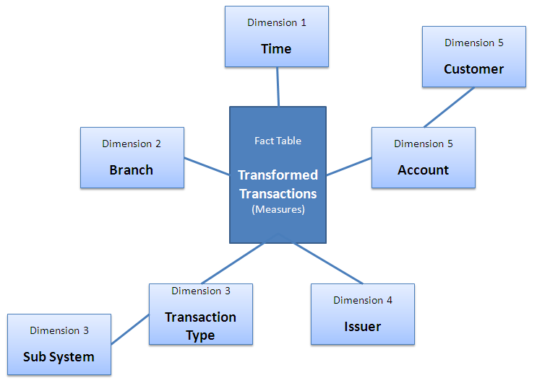
مثال Snowflake Schema

Slide 25
Example of Fact Constellation
time
time_key
day
day_of_the_week
month
quarter
year
item
Shipping Fact Table
item_key
item_name
brand
type
supplier_type
time_key
Sales Fact Table
time_key
item_key
item_key
shipper_key
branch_key
from_location
location_key
to_location
branch
location
branch_key
branch_name
branch_type
units_sold
location_key
street
city
province_or_state
country
dollars_cost
dollars_sold
units_shipped
avg_sales
shipper
Measures
shipper_key
shipper_name
location_key
shipper_type

Slide 26
Measures of Data Cube: Three Categories
Distributive: if the result derived by applying the function to n aggregate values is the same as that derived by applying the function on all the data without partitioning
E.g., count(), sum(), min(), max()
Algebraic: if it can be computed by an algebraic function with M arguments (where M is a bounded integer), each of which is obtained by applying a distributive aggregate function
E.g., avg(), min_N(), standard_deviation()
Holistic: if there is no constant bound on the storage size needed to describe a subaggregate.
E.g., median(), mode(), rank()

Slide 27
A Concept Hierarchy: Dimension (location)
all
all
region
Europe
...
North_America
country
Germany
...
Spain
Canada
...
Mexico
city
Frankfurt
...
Vancouver
...
Toronto
office
L. Chan
...
M. Wind

Slide 28
Multidimensional Data
Sales volume as a function of product, month, and region
Dimensions: Product, Location, Time
Hierarchical summarization paths
Region
Industry Region Year
Category Country Quarter
Product City Month Week
Office Day
Product
Month

Slide 29
Typical OLAP Operations
Roll up (drill-up): summarize data
by climbing up hierarchy or by dimension reduction
Drill down (roll down): reverse of roll-up
from higher level summary to lower level summary or detailed data, or introducing new dimensions
Slice and dice: project and select
Pivot (rotate):
reorient the cube, visualization, 3D to series of 2D planes

Slide 30
Typical OLAP Operations

